Slide 1
Engine starting System Prepared by Mayuri kADAM

Slide 2
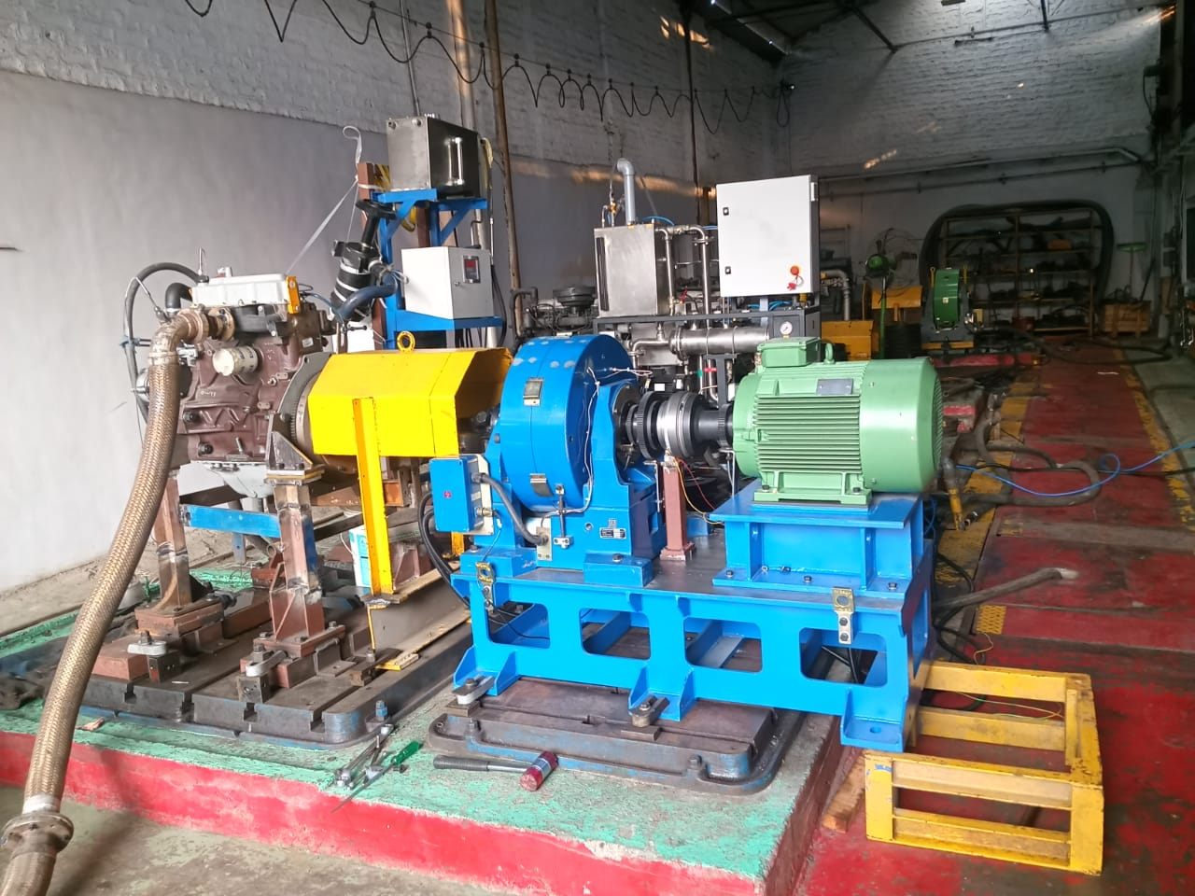
Induction Motor

Slide 3
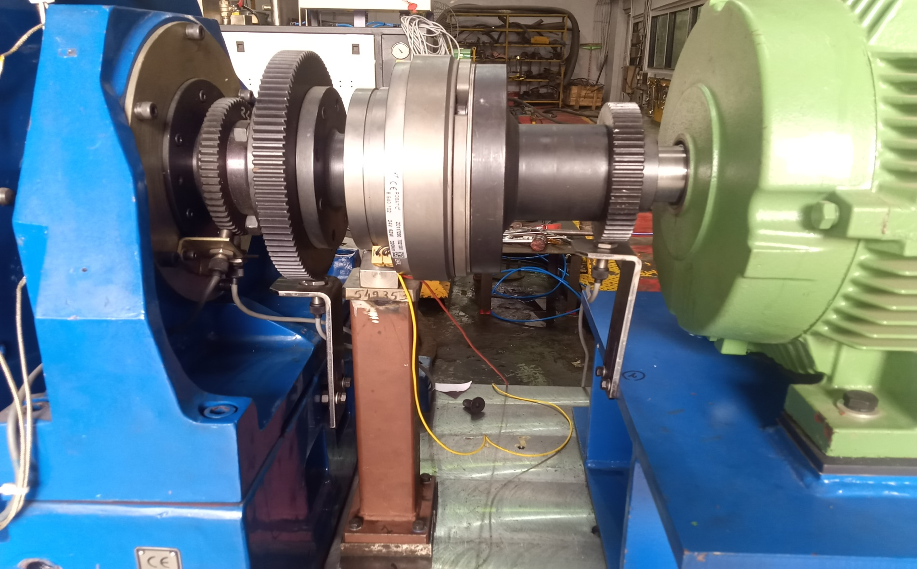
Magnetic pulse pick up sensors

Slide 4
The system is provided to facilitate engine cranking operation from the back end of the Dynamometer
The system consists of :-
AC motor (Induction motor )
it is selected for engine cranking
Electromagnetic Clutch for engaged & disengaged shaft between Induction motor & dynamometer
Which has supply voltage input 24VDC
Variable speed drive
it is used for varying speed or set speed of motor .
60 Tooth wheel with magnetic pulse pick up (qty.no.2) to sense rpm (speed)
MS FIXTURE for motor mounting arrangement to suit as per requirements
Guard on rotating part

Slide 5
LOGIC :
We have to give speed to induction motor through VFD drive
If our Engine IDLE speed is 600 rpm then we have to set speed of induction motor is lower than Engine Idle speed
As our dynamometer is connected to engine via cardon shaft Dynamometer speed is equal to Engine speed .
TWO 60 tooth wheel are connected at dynamometer side & Induction motor side.
Also Two quantity magnetic pulse pick sensors are connected at both wheel .
So that sensor sense SPEED ( RPM )when it sense 60 teeth then it gives 1 RPM as so on.
First step to engaged clutch & give speed input to induction motor through VFD drive after that motor will run at set speed this speed is transferred to dynamometer through shaft
As our dynamometer connected to Engine it transfer speed to engine when one stroke will completed .then Engine will start running with its IDLE SPEED
We have getting two speed this two speed compared & when engine speed is greater than motor speed then clutch disengaged .
Motor speed hold its speed for set particular time until engine will run its idle speed . & Automatically stop induction motor .
After that we will run engine at high idle by using throttle actuator & take load test cycle .

Slide 6
